Slide 1

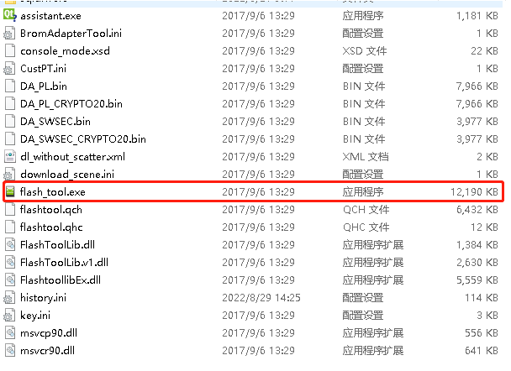
Detailed steps for using the upgrade tool
Open the compressed package of the upgrade tool. After unpacking, open the folder and select the item marked in the figure

Slide 2
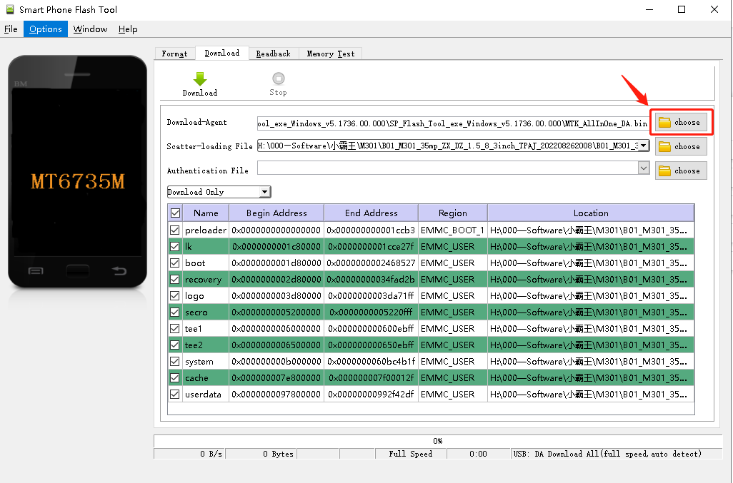
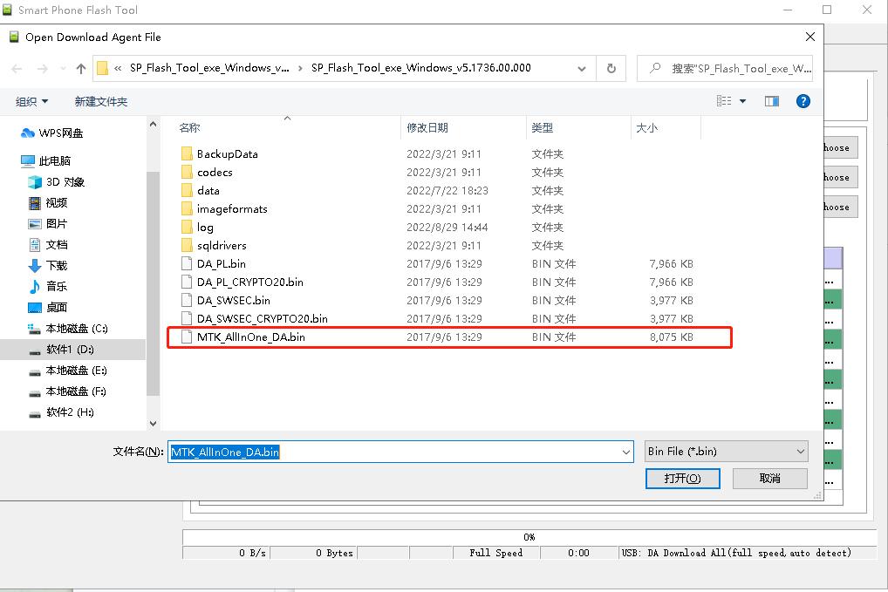
Click the mark in Figure 1 and select the mark option in Figure 2
Figure 1
Figure 2

Slide 3
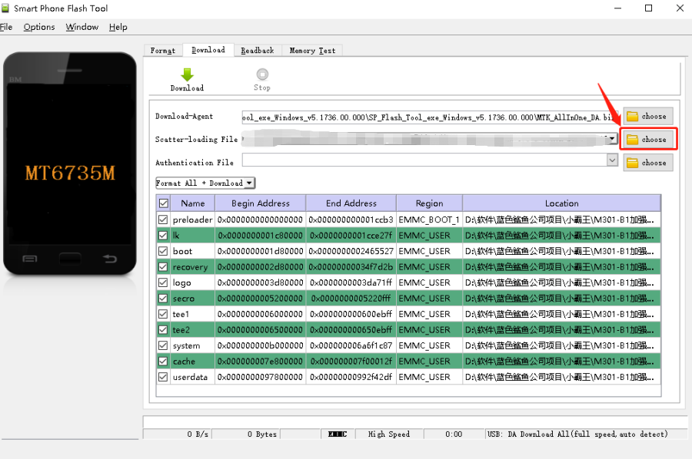
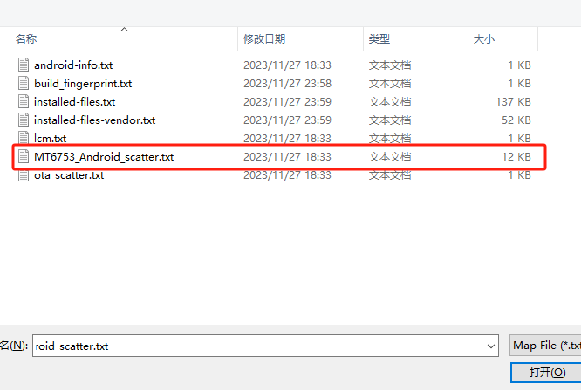
Click the mark in the following figure and select the path where the upgrade software is stored in the drive letter

Slide 4
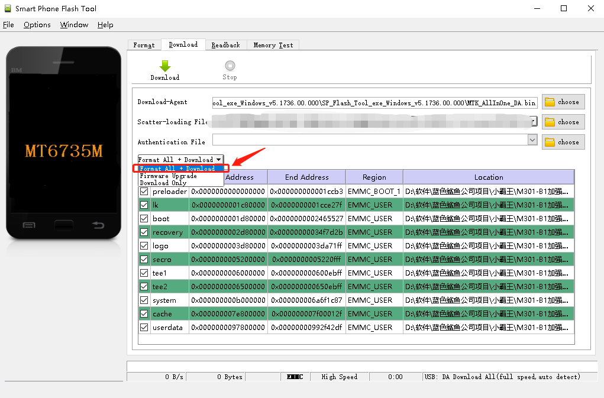
Select format all + download in the upgrade mode

Slide 5
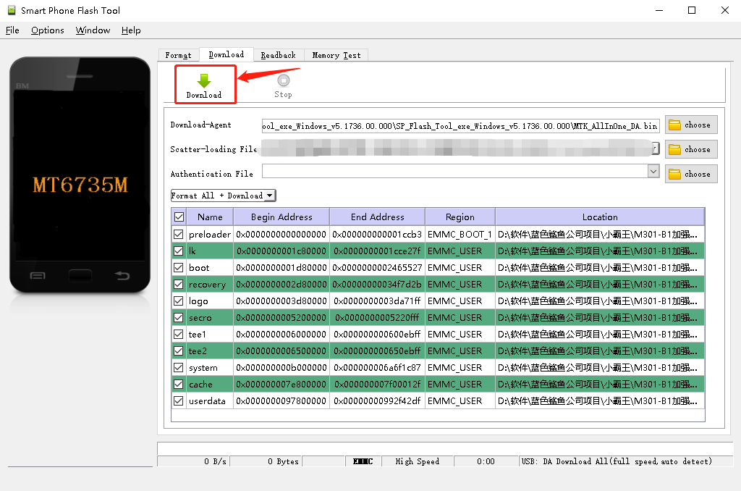
Finally, click download to confirm that the device has been completely shut down, and then insert USB to upgrade

Slide 6
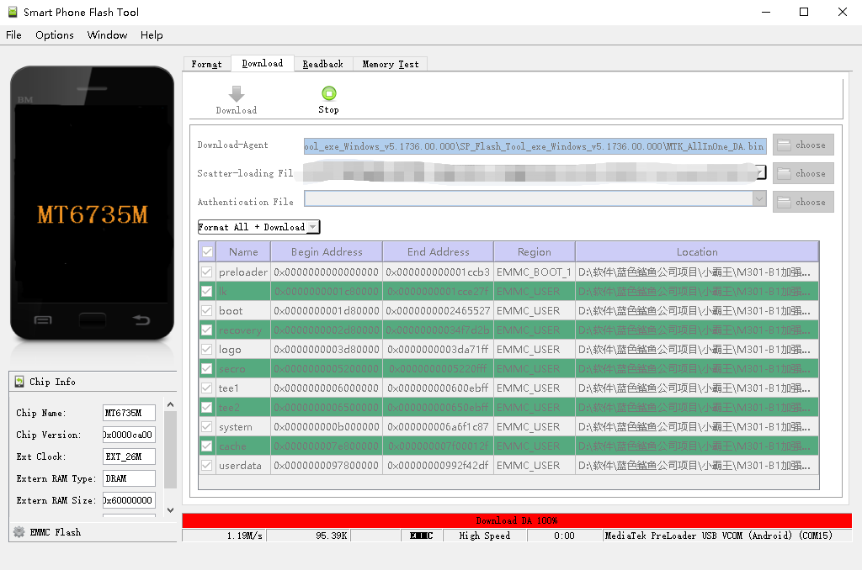
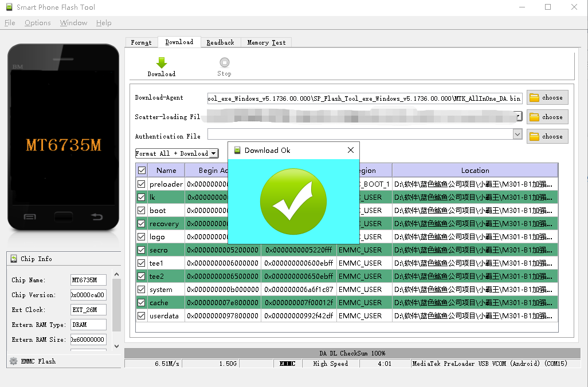
As shown in Figure 1, the USB has been inserted, and Figure 2 shows that the upgrade has been completed
Figure 1
Figure 2

Slide 7
The above is the whole process of using the upgrade tool
Thank You!
Prepared by：Fantasy
August 29(st), 2024

